Slide 1
Junction Studio
Jane Kim

Slide 2
What I chose to do
I created a website for a made-up art studio called Junction Studio.
The website has 5 pages: Home, About, Classes, Gallery, and Contact.
Each page has a different layout.
My website uses a parallax effect.
I tried to have a darker color scheme.

Slide 3
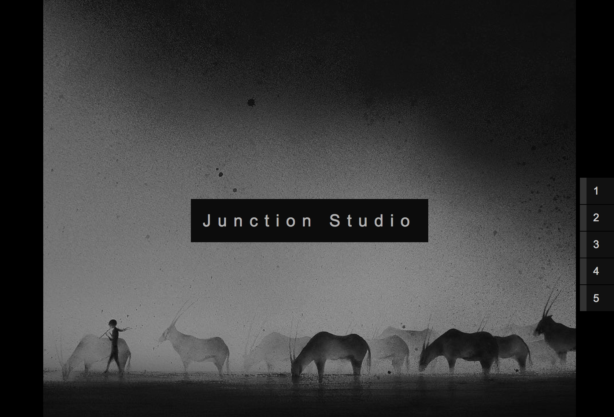
Home Page
This is my Home page.
There is an opacity effect on this image. I decided to include this because it made the image less harsh and softer.
There are also scroll buttons on the right that link to each separate page.

Slide 4
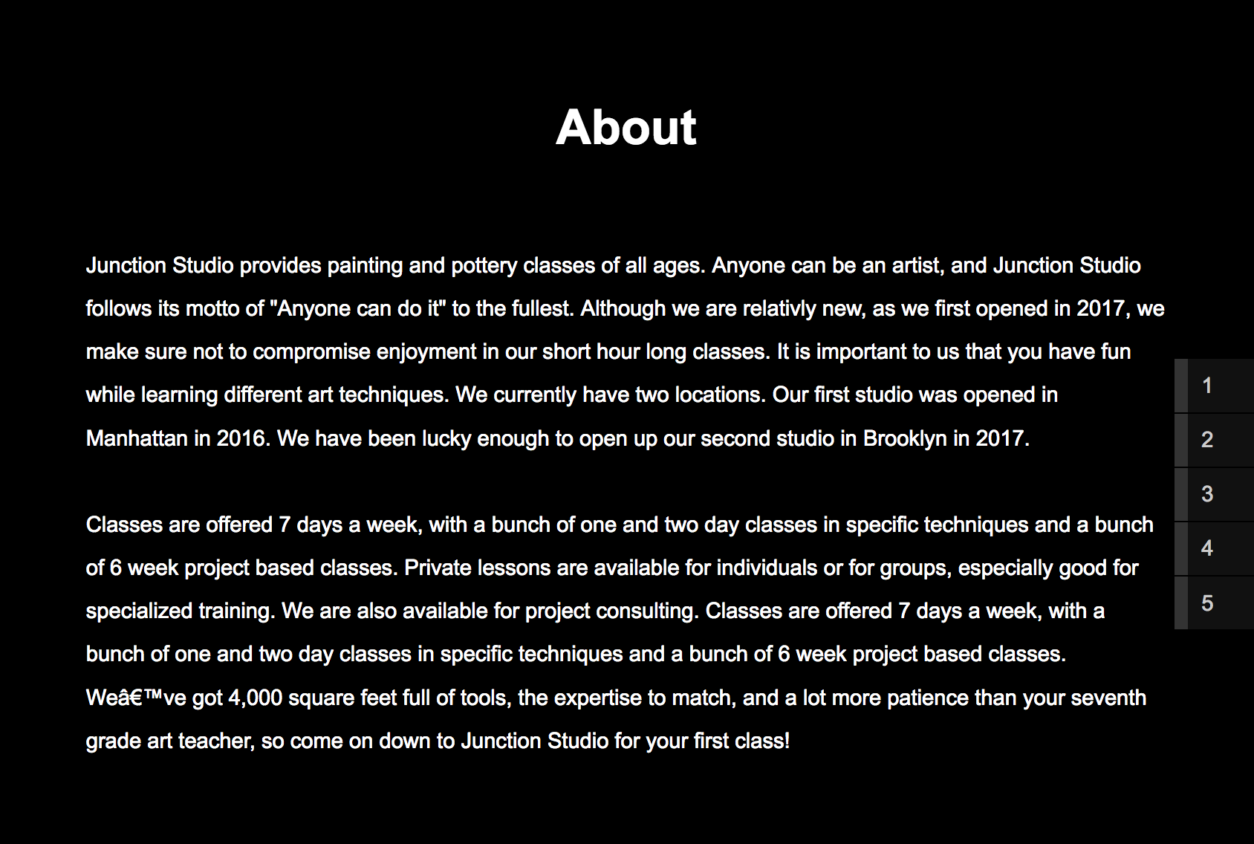
About Page
This is my About page.
I wanted to keep this page relatively simple because it is mostly content based.

Slide 5
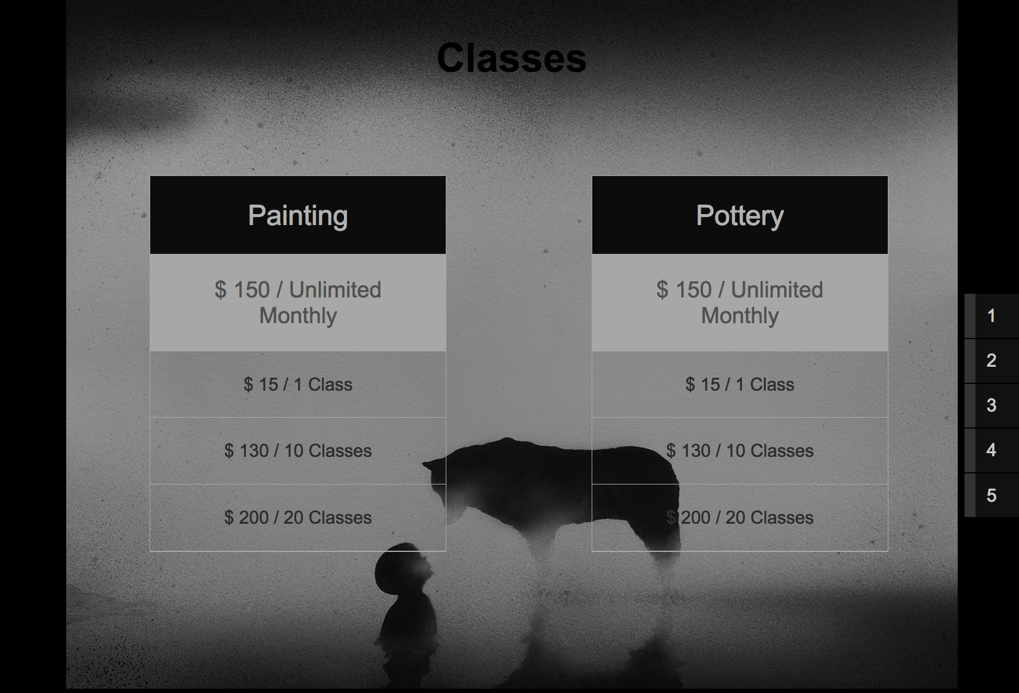
Classes Page
This is the Classes Page.
I chose to create two boxes that had the pricing of the two classes that are offered.
I have also included the pricing of the classes.
I chose to use a chart format because I thought it would be the most clear way to show this information.
When hovered over, on the box, there is a black hover shadow.

Slide 6
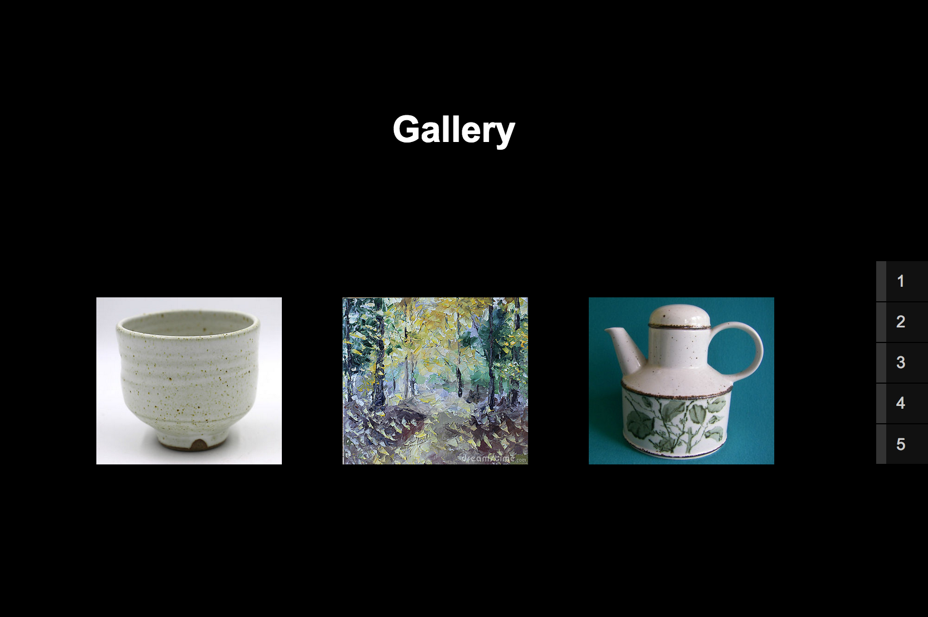
Gallery PAge
This is my Gallery Page.
It is in a lightbox gallery format.
If you click on the image it will create a pop-up window with an enlarged version of the image.
When the viewer clicks on the image, on the top left order, there is a counter for which number image the viewer is on.

Slide 7
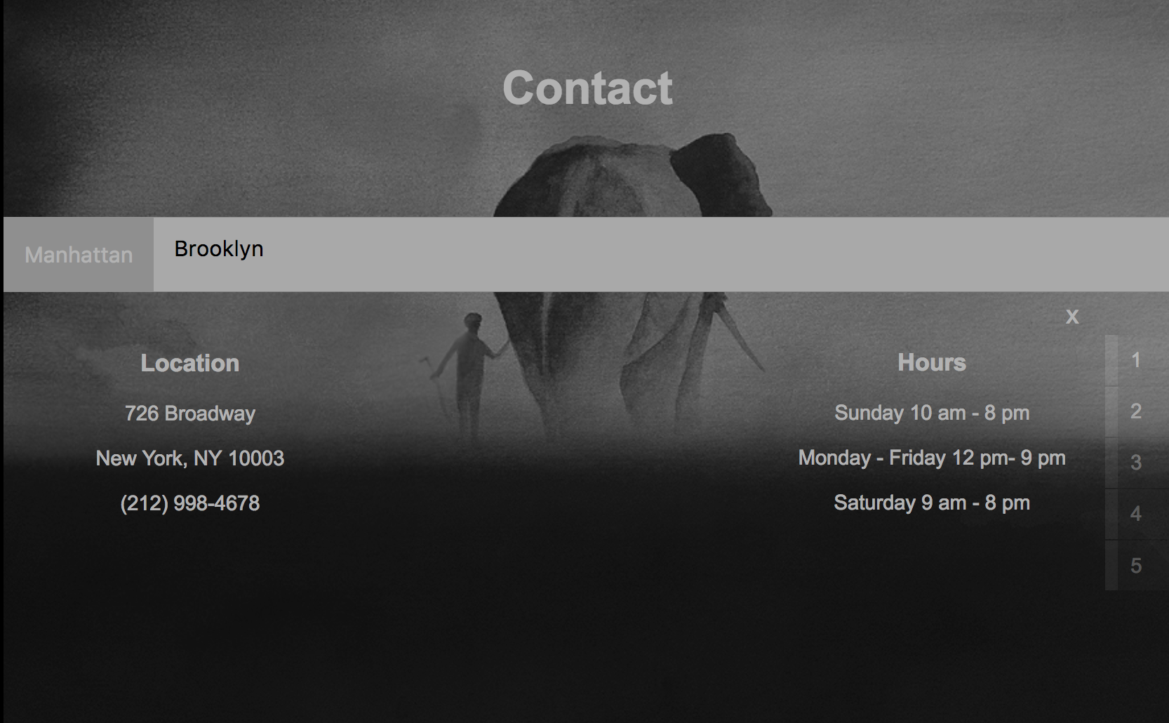
Contact Page
This is my Contact page.
I gave my studio two locations, one in Manhattan and one in Brooklyn.
I decided to make it a page with a toggling tab.
Within each tab, the location, hours, and phone number are stated.
There is also an “x” that can be used to exit out of the tab.
I also decided to float the location to the left and the hours to the right because I wanted the center to be empty so that the viewer can see the image better.

Slide 8

Footer Section
This is my footer section, and it is at the bottom of the page.
There are icons that link to a website.

Slide 9
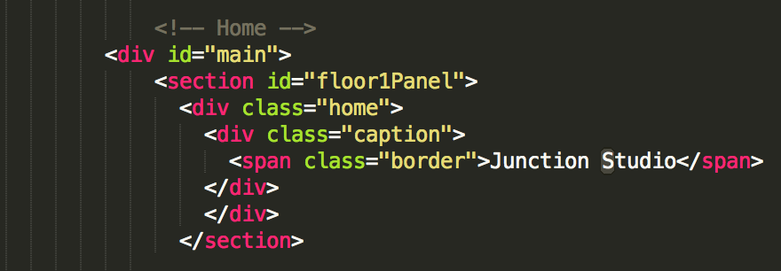
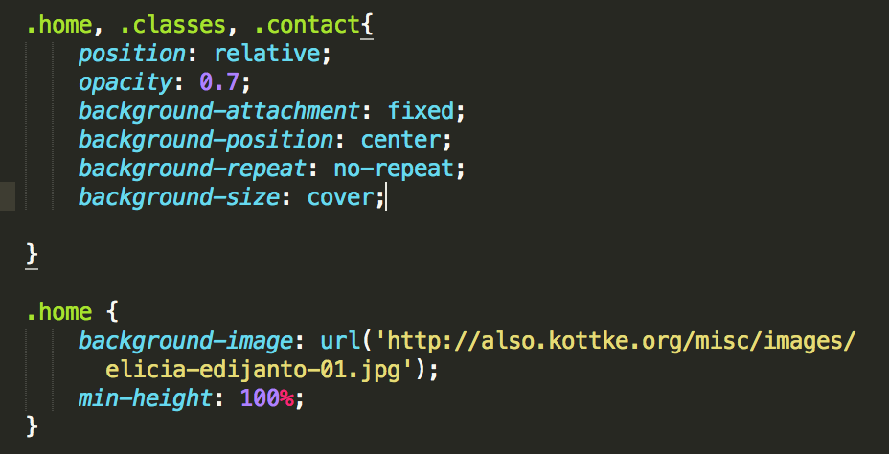
Code Snippet
This is an snippet of my code for my home page.
First I created a main div that would contain all of my pages.
Next, I separated each page into a different section and named them with different ids.
Within the section, I created a div in order to upload the pictures to each section.
In my CSS code, I had to make sure that the background was fixed, and I also had to make sure that the size would cover the screen.
I also decided to add in a little opacity in order to soften the website.

Slide 10
Issues I encountered
Difficulties:
I had a lot of trouble with organization.
Because every page required a different layout, it was important that I remembered what I had named all of the divs. Specifically, I had forgotten to specify which unordered list I wanted for my scroll buttons, and my unordered list from my chart moved over to where my scroll buttons were suppose to be.
I had trouble with the colors. Because my background was grey, I didn’t know if white would be legible or black. I decided to go with both.

Slide 11
What I learned in order to accomplish your project
Things I learned:
how to create a lightbox gallery for my Gallery page.
how to create charts for my Classes page.
how to make a website with a parallax effect.
using greensock and jquery to linking id’s of divs in order to scroll through pages instead of linking pages
creating toggle buttons

